Slide 1
Final Project
a student life system
Zhao Qinjian
Chen Chengxuan 1234763
Shen Yiming 1235416

Slide 2
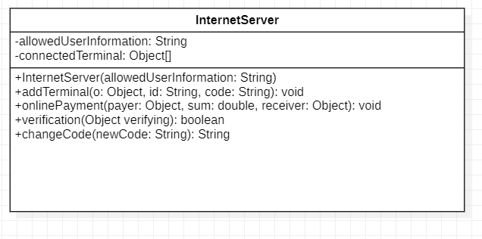
UML

Slide 3
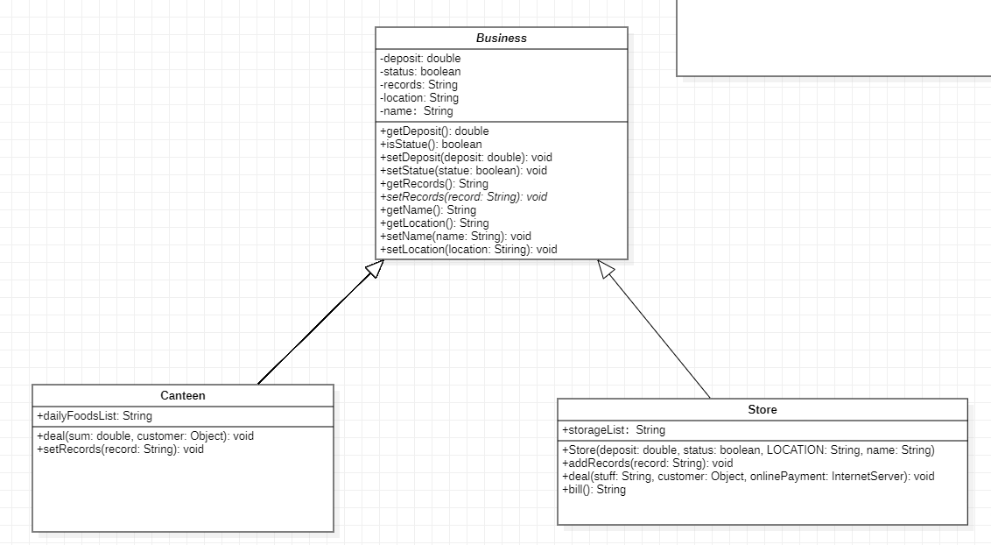
UML

Slide 4
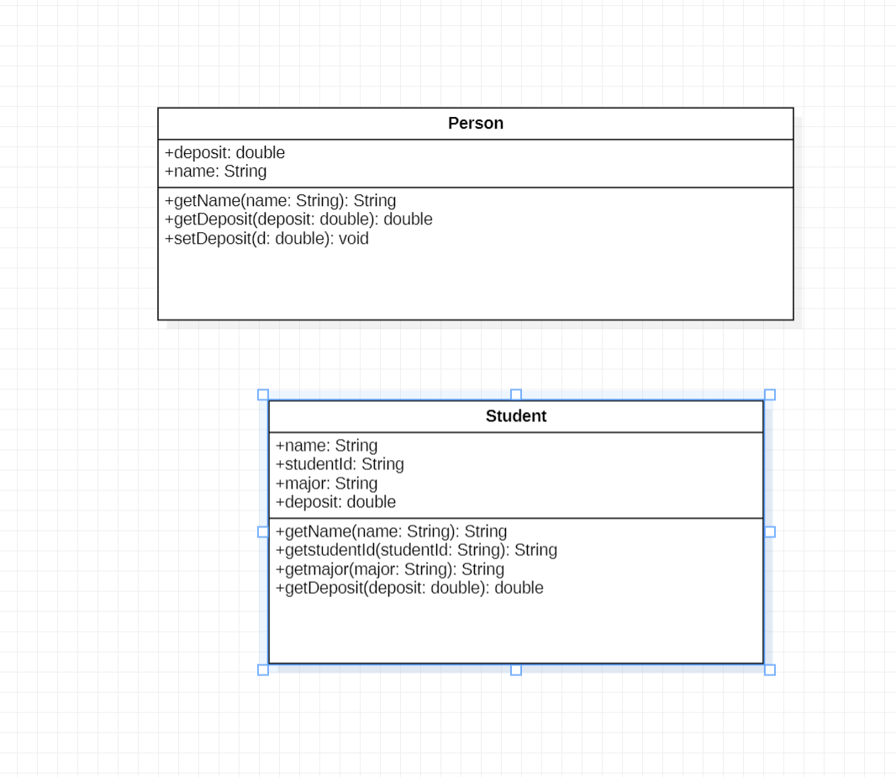

Slide 5
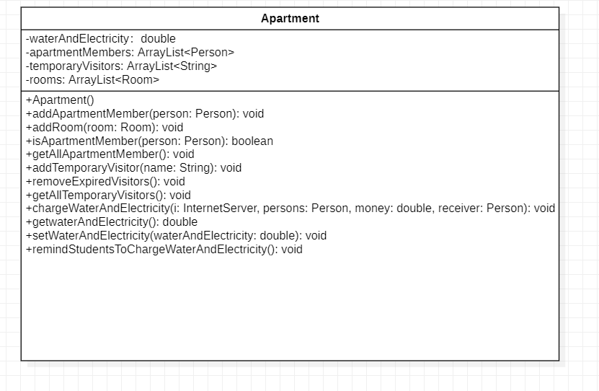
UML

Slide 6
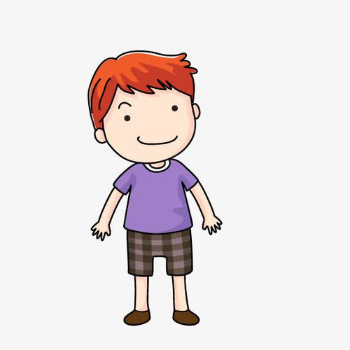
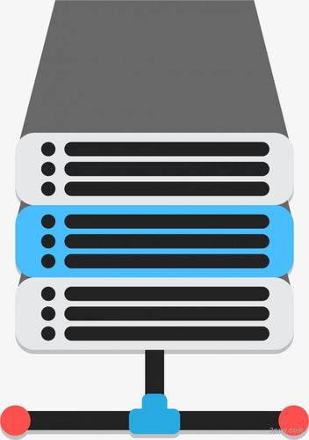
It is 5/29 2023 at 0:00 AM Everyone is sleeping, but our school server restarts and begins its work
You are not allowed to use this service
Please find IT support for more information
I am Bob, a cps student, and I live in the Bamboo very close to the canteen
it is the end of this semester, so I only has 5 yuan left
It seems that I did not connect to the server that is t use the school service
(Bob are trying to connect to the server)

Slide 7
Like his steam, Bob forgot his code. What a poor guy.
(Bob is trying to change his code)
Thank God, just 8:00 AM. Bob needs to get to Canteen for something to eat early
Please REMEMBER your new code user Bob123
CODE:1592574
Please remember your key index 0
when you are using other Terminal, you can use this index to find the necessary information

Slide 8
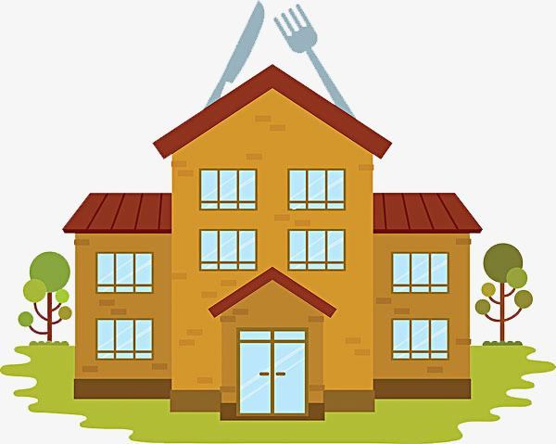
Canteen is connected to the local server sucessfully
Please remember your key index 1
when you are using another Terminal, you can use this index to find the necessary information

Slide 9
What a PITY!!! There are no more noodles, so Bob chooses to drink a cup of orange juice
Open at Mon May 29 00:38:34 CST 2023Canteen Canteen No.2
OH~~NO!!,Bob only has 5.0Yuan, his only choice is an egg
Sorry, we do not offer
that food
So, Bob got an egg and the following is a record from the canteen
Bob wants to eat noodles

Slide 10
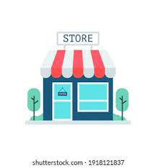
At now, Bob only has 3.0, But DO NOT worry, he is working at the store,
Congrats! Bob has 15060.0Yuan The store will pay his salary of this semester
Bob wants to eat noodles

Slide 11
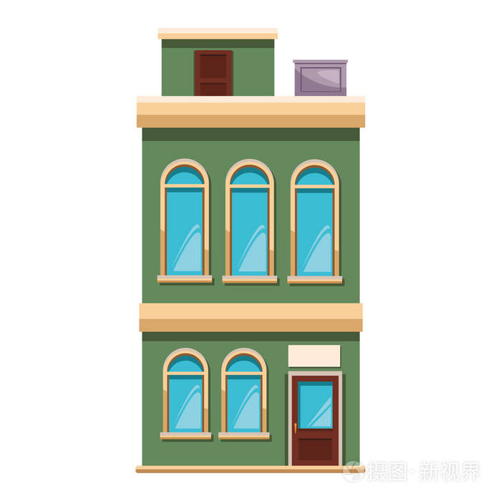
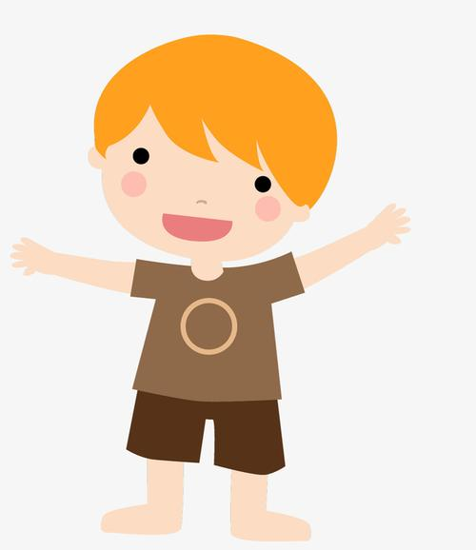
Bob decided to go to the apartment to rest and relax with his friends Alen properly
Alen is not a member of bamboo///
However, since Alen does not belong to bamboo, he needs to register as a temporary visitor to enter the dormitory///
Alen glanced at the temporary registration formthere were other students on it
Chucky 10
Alex 12
Alen 13

Slide 12
After registering, Alen went to Bob's bedroom to play games together, however, there was a sudden power outage
Reminder: Bob, please charge water and electricity. the water and electricity is only -0.9///
Then Bob started picking up his phone to pay the bill
Charging water and electricity for the apartment.
Then the dormitory had electricity again, and the two began to study CPS2231
Unknowingly, after a busy day, the time came to 22:00, and Alen's visitor time as a student also arrived
No name on visitor list, After a busy day, Bob and Alen are going to wash up and get ready for bed

Slide 13
感谢观看
Thanks for watching.

